Slide 1
Audit Management System POD 1
Presented by
Prekatanothu Sairam (921465)
Tanya Garg (922271)
Shivam Seetha (922591)
Girish Goud (922571)
Presented to
Mr. T. Thiyagaraja (Mentor)
Mr. Nilay Das (Trainer)
Ms. Keerthana Ganesh (HR)

Slide 2
Problem Statement
A leading supply chain management organization is willing to automate the Audit processing in order to make the management scalable and ensure clarity and ease of tracking.
Therefore, it wants us to develop an Audit Management System.
As a full stack developer our work was to develop and deploy multiple microservices in Amazon Web Services (AWS).
The UI part was done with the help of Angular.

Slide 3
Microservices
Audit Authorization
Audit Benchmark
Audit Checklist
Audit Severity

Slide 4
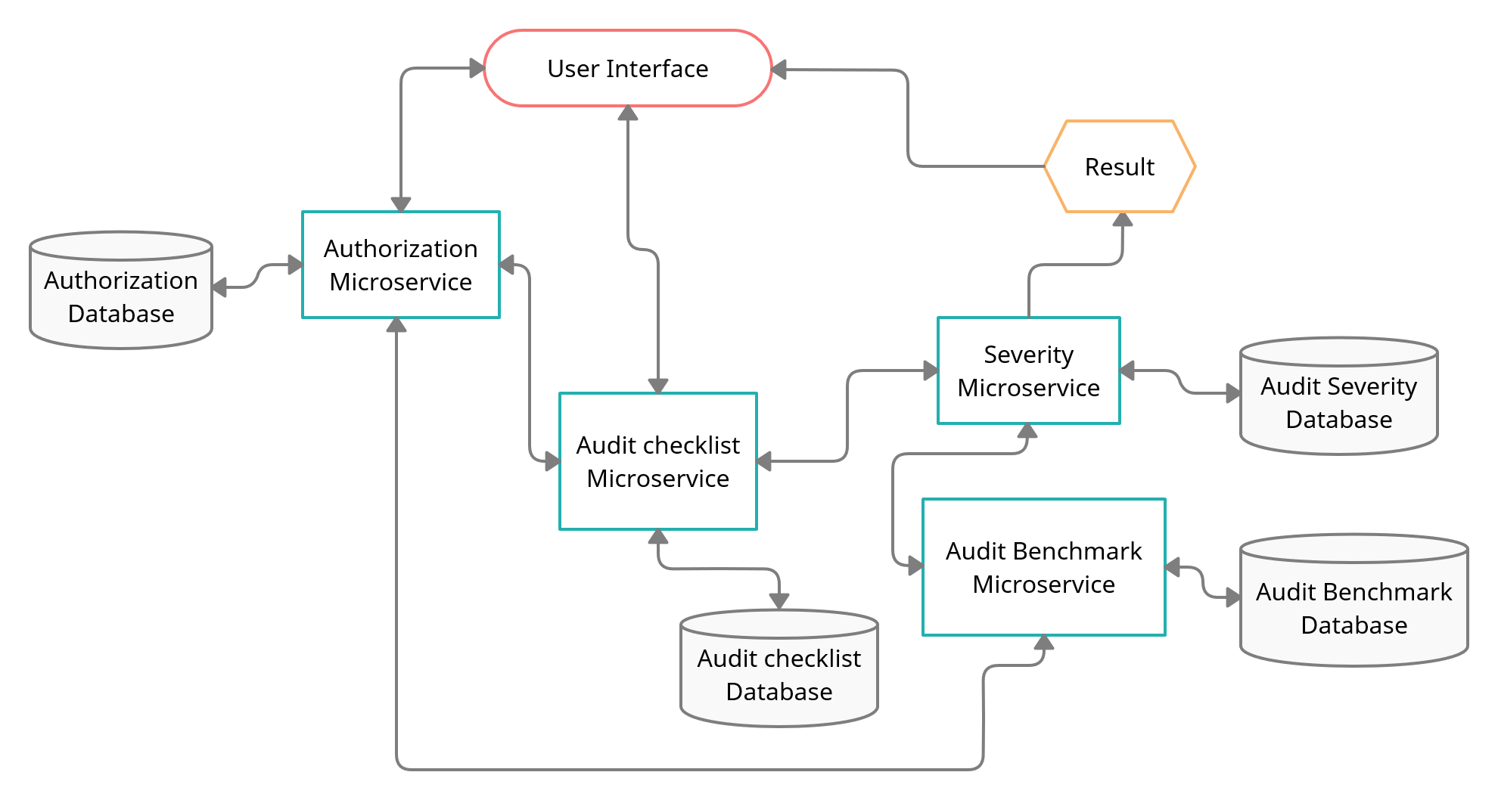
Flowchart

Slide 5
Audit-Authorization
Authentication and Authorization part of project.
It creates JWT (JSON Web Token) for an authenticated user who is in Database and then it validates the user based on the JWT token passed in the "Authentication"-Request-Header.
Method:
GET:/health-check
POST:/authenticate
POST:/validate

Slide 6
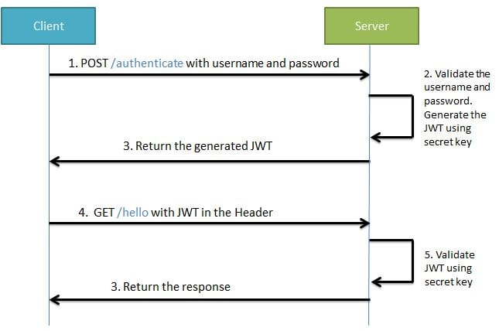

Slide 7
Audit-Benchmark
It is a middleware microservice which stores the number of acceptable “No” in the database based on Audit Type.
It uses data.sql which stores Benchmark ID, Audit Type and Bechmark “No” answers.
It is used to pass the number of list of acceptable “No” to audit-severity microservice.
Method:
GET:/audit-benchmark
GET:/health-check

Slide 8
Audit-Checklist
It is a middleware microservice which gets the list of questions from H2 database.
It uses data.sql which stores Question ID, Question, Audit Type and Response.
The returned list is used by the audit-severity to display questions based on the type selected by the user.
Method:
GET:/auditchecklistquestions
GET:/health-check

Slide 9
Audit-Severity
It is a middleware microservice which invokes audit-benchmark microservice and takes the list of acceptable “No” from it and it also takes questions from audit-checklist based on that generates the response.
It then checks the project execution status according to the pre-set rules.
It returns the status and remedial action to be taken.
Method:
POST:/projectexecutionstatus
GET:/health-check

Slide 10
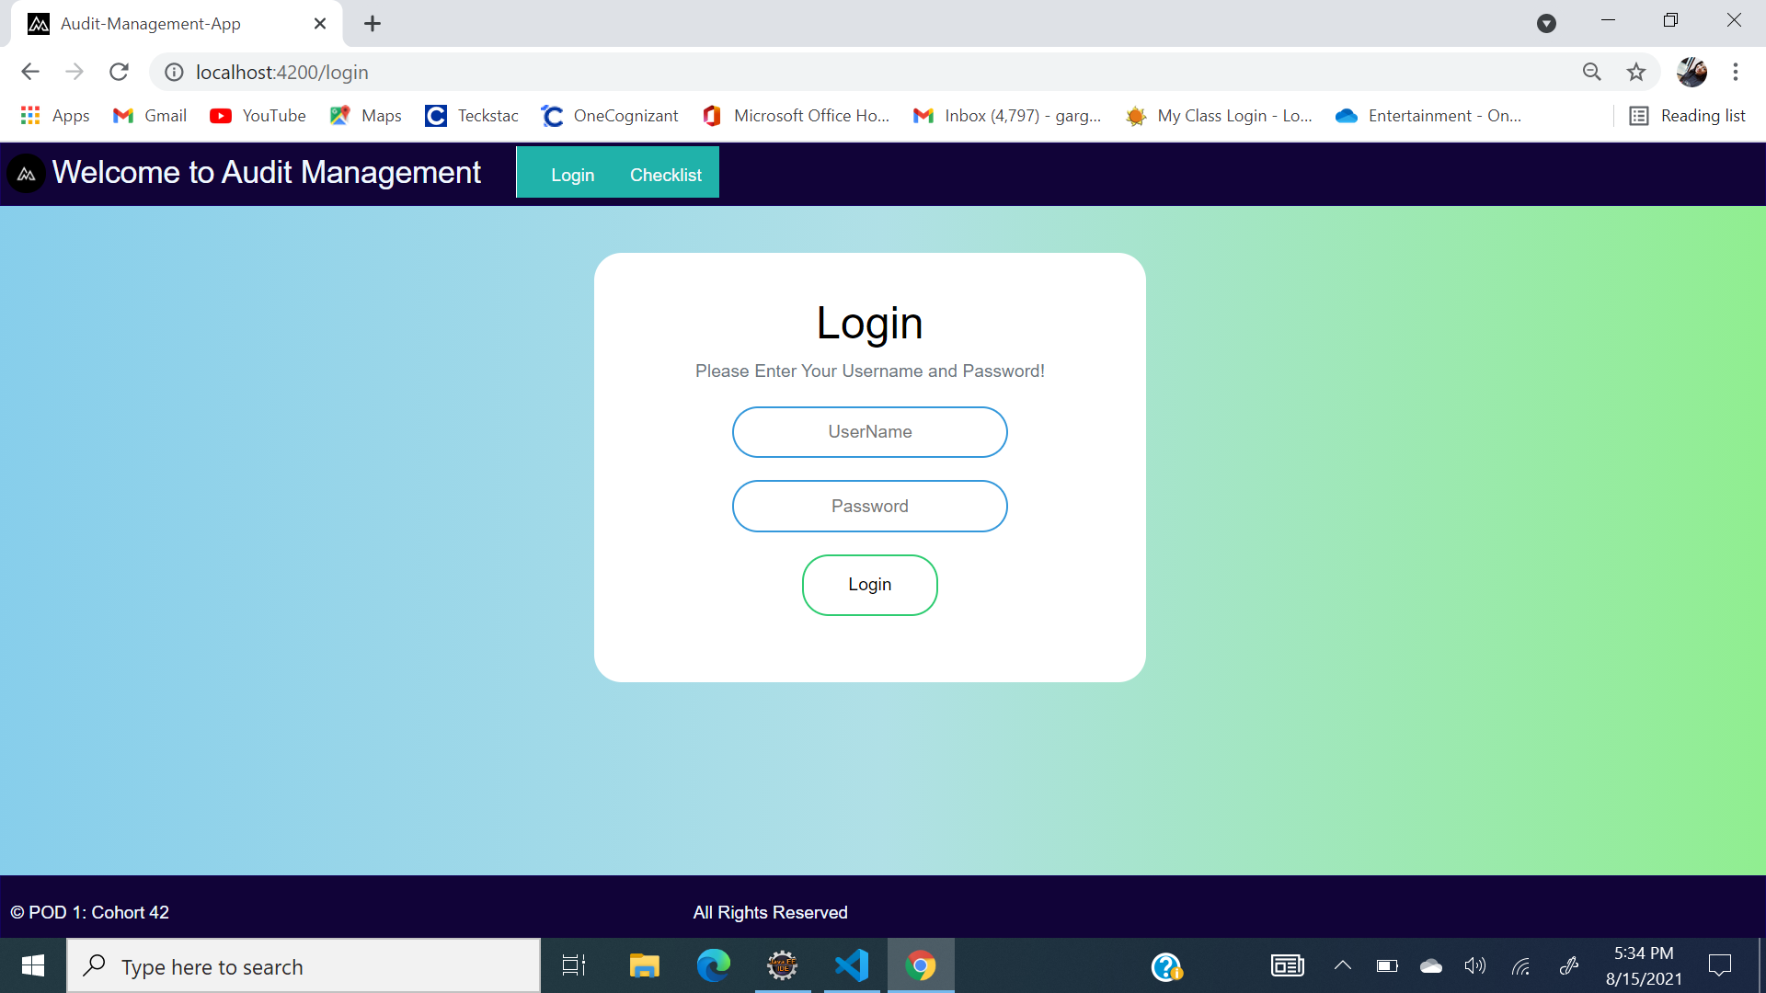
User Interface

Slide 11
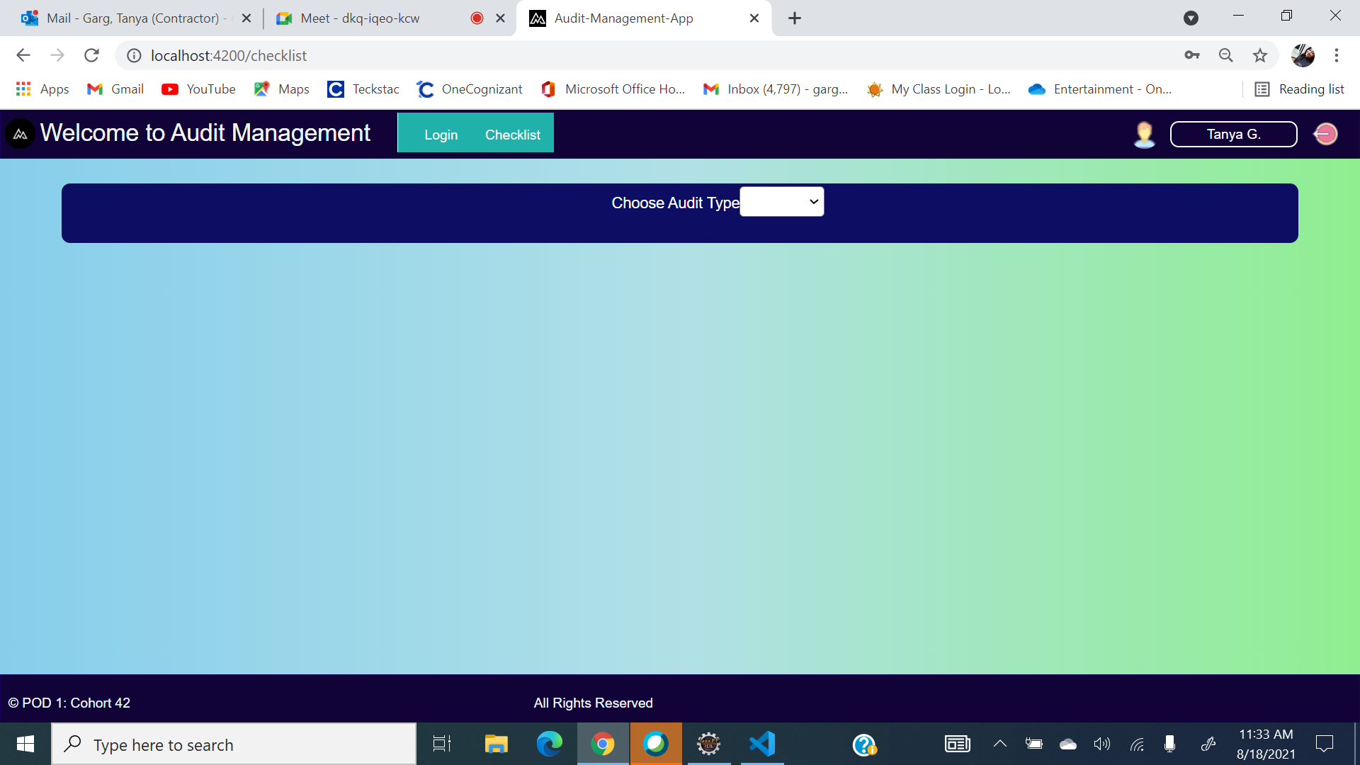
User Interface

Slide 12
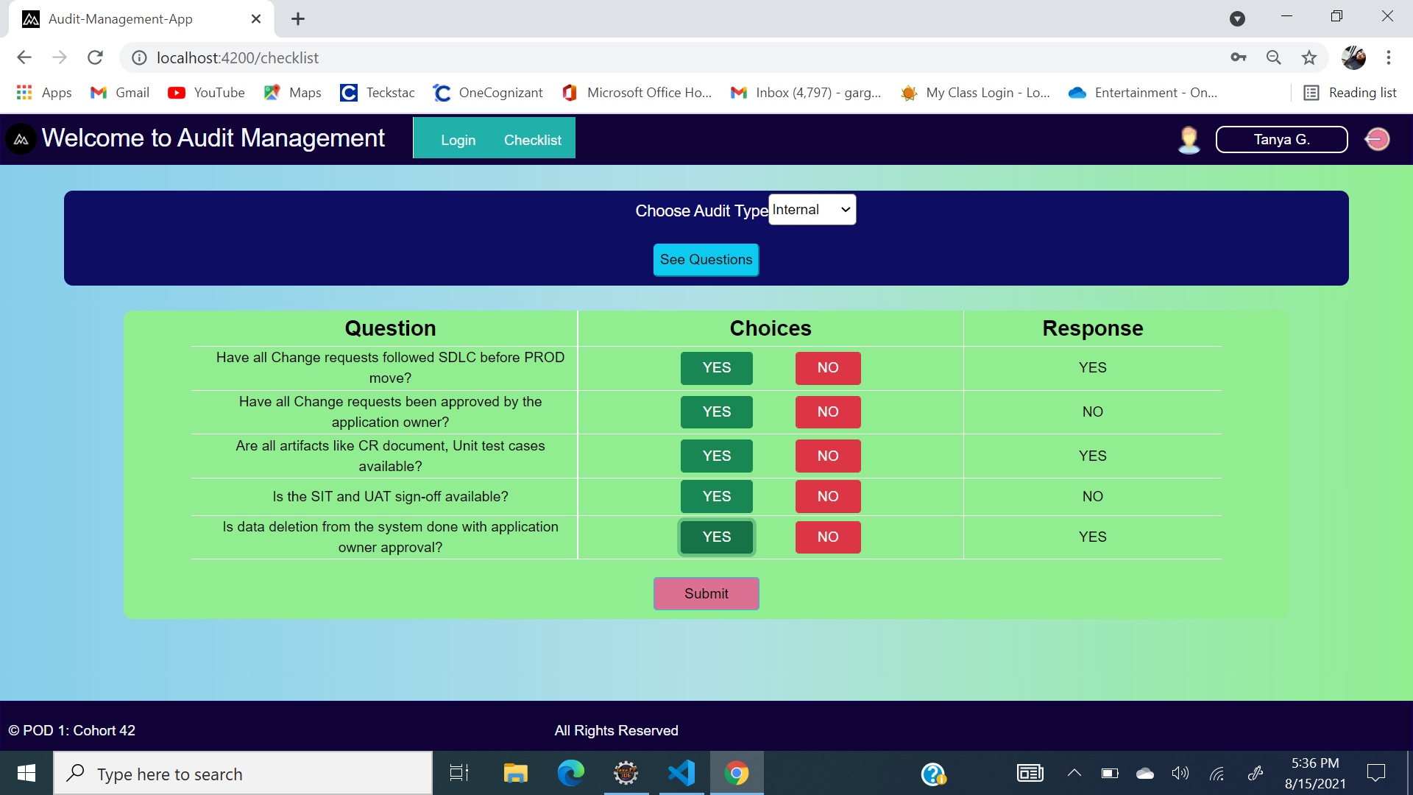
User Interface

Slide 13
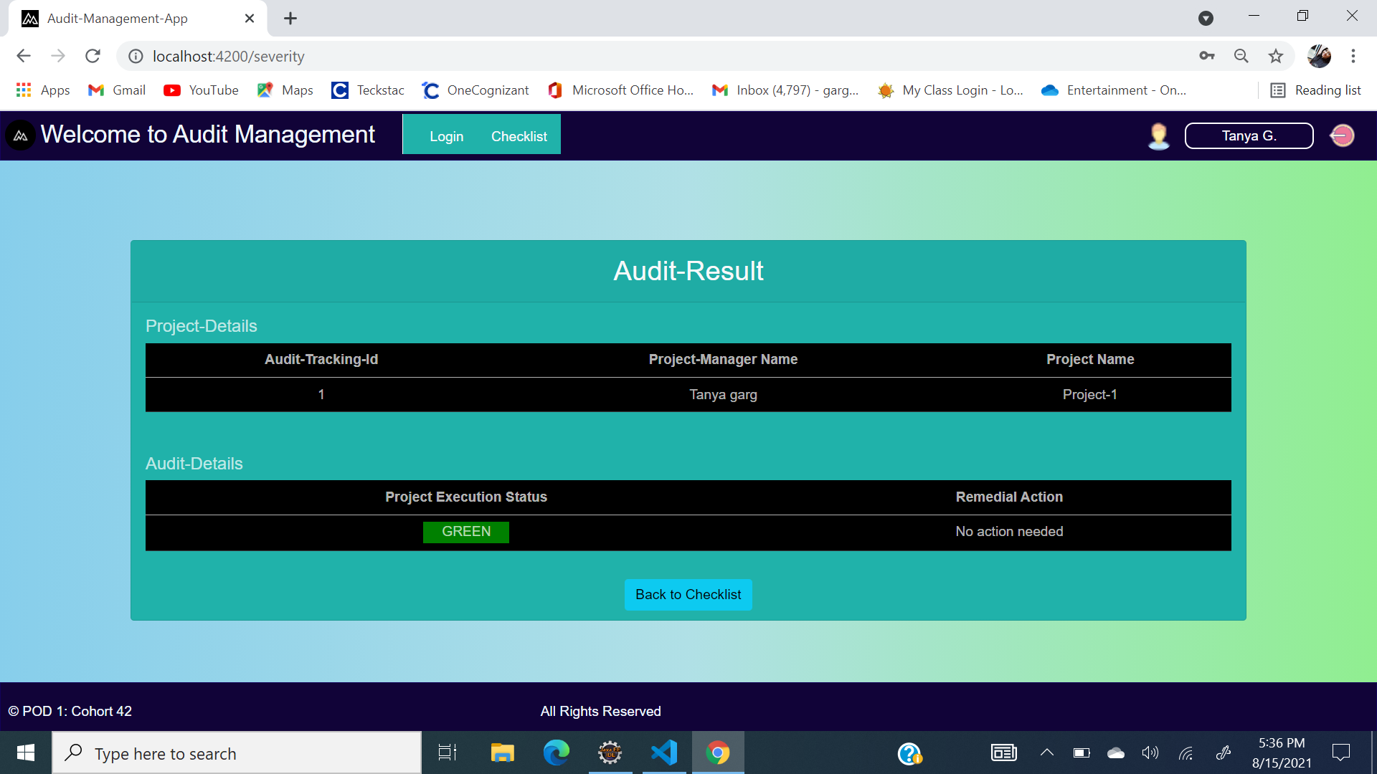
User Interface

Slide 14
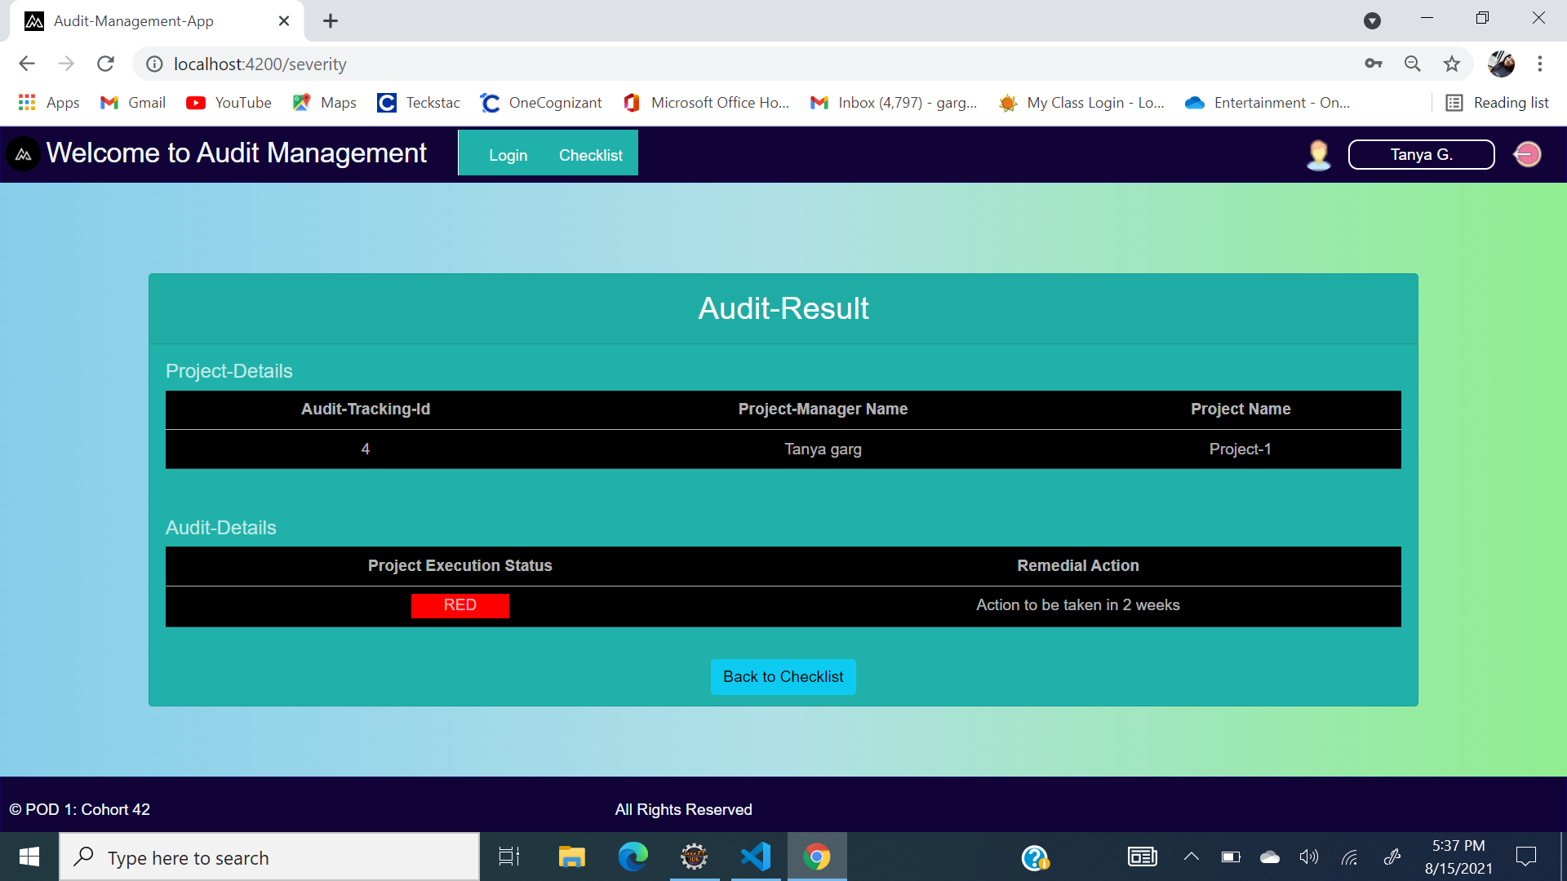
User Interface

Slide 15
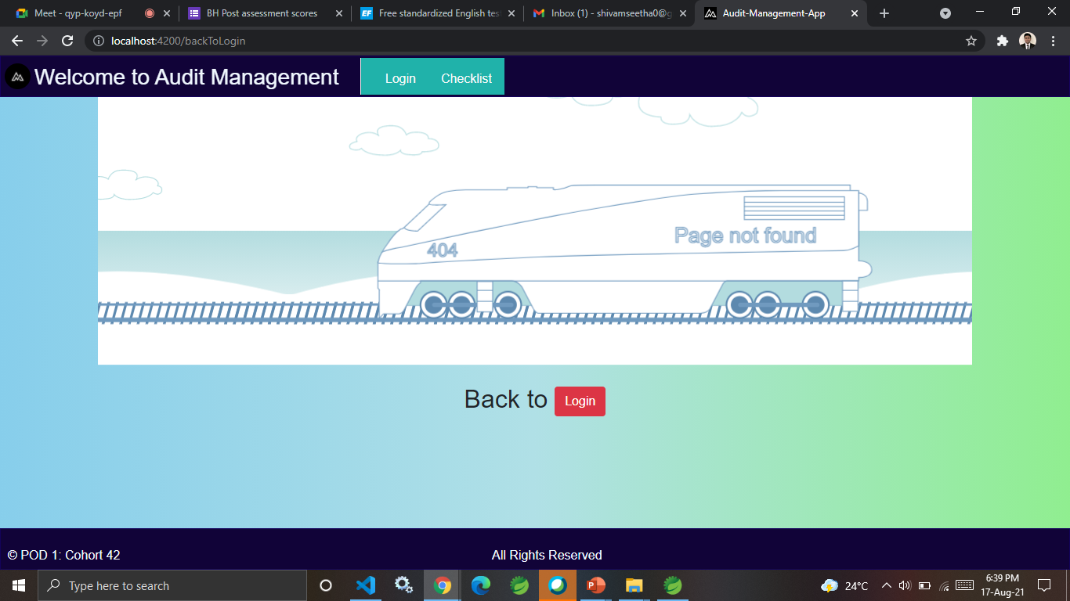
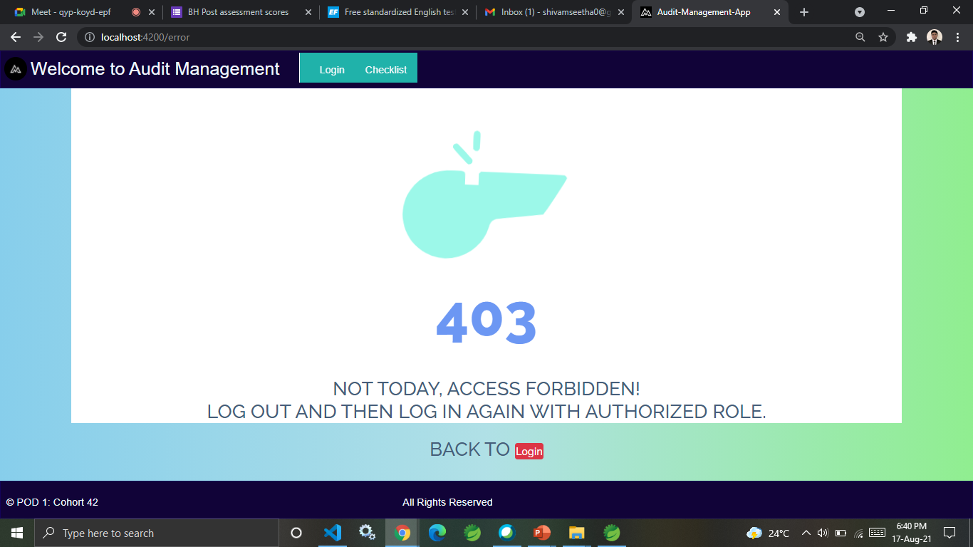
Error screens

Slide 16
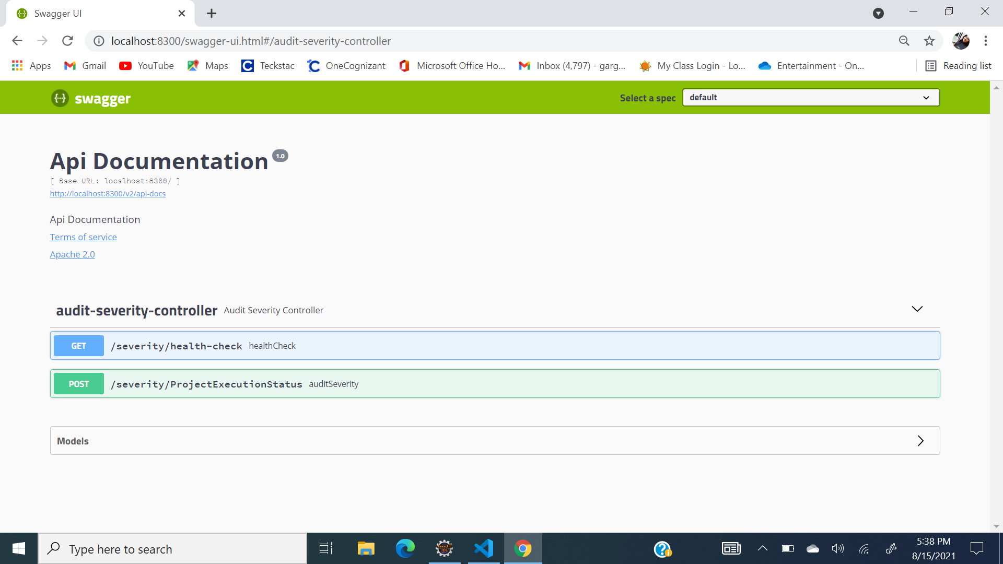
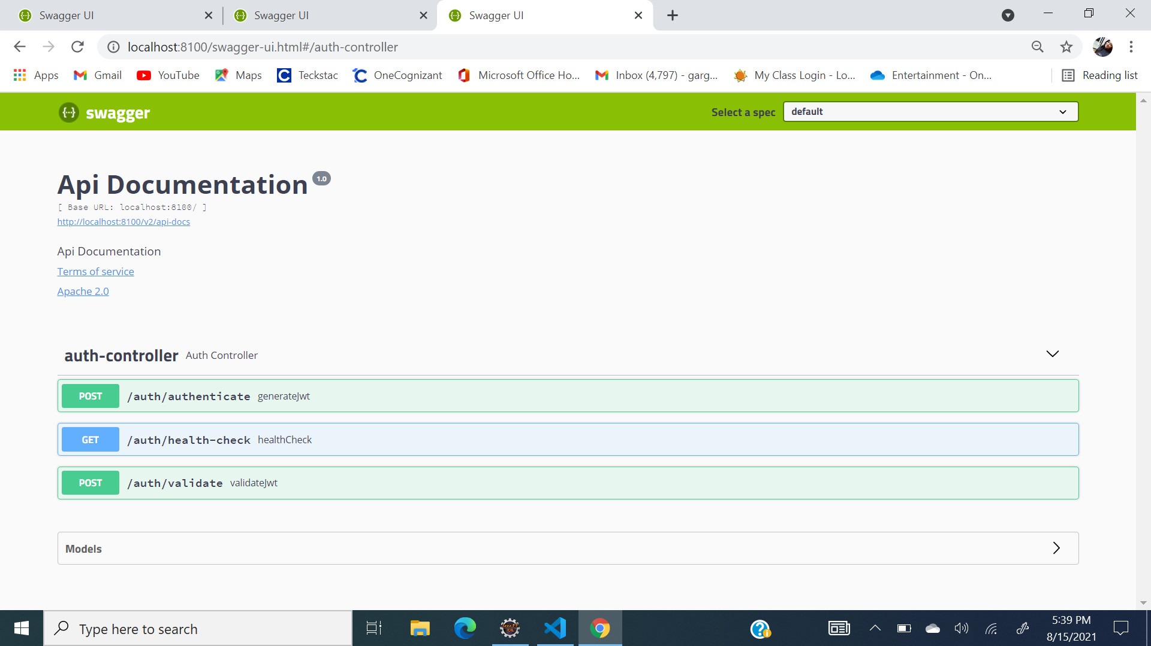
Swagger-UI

Slide 17
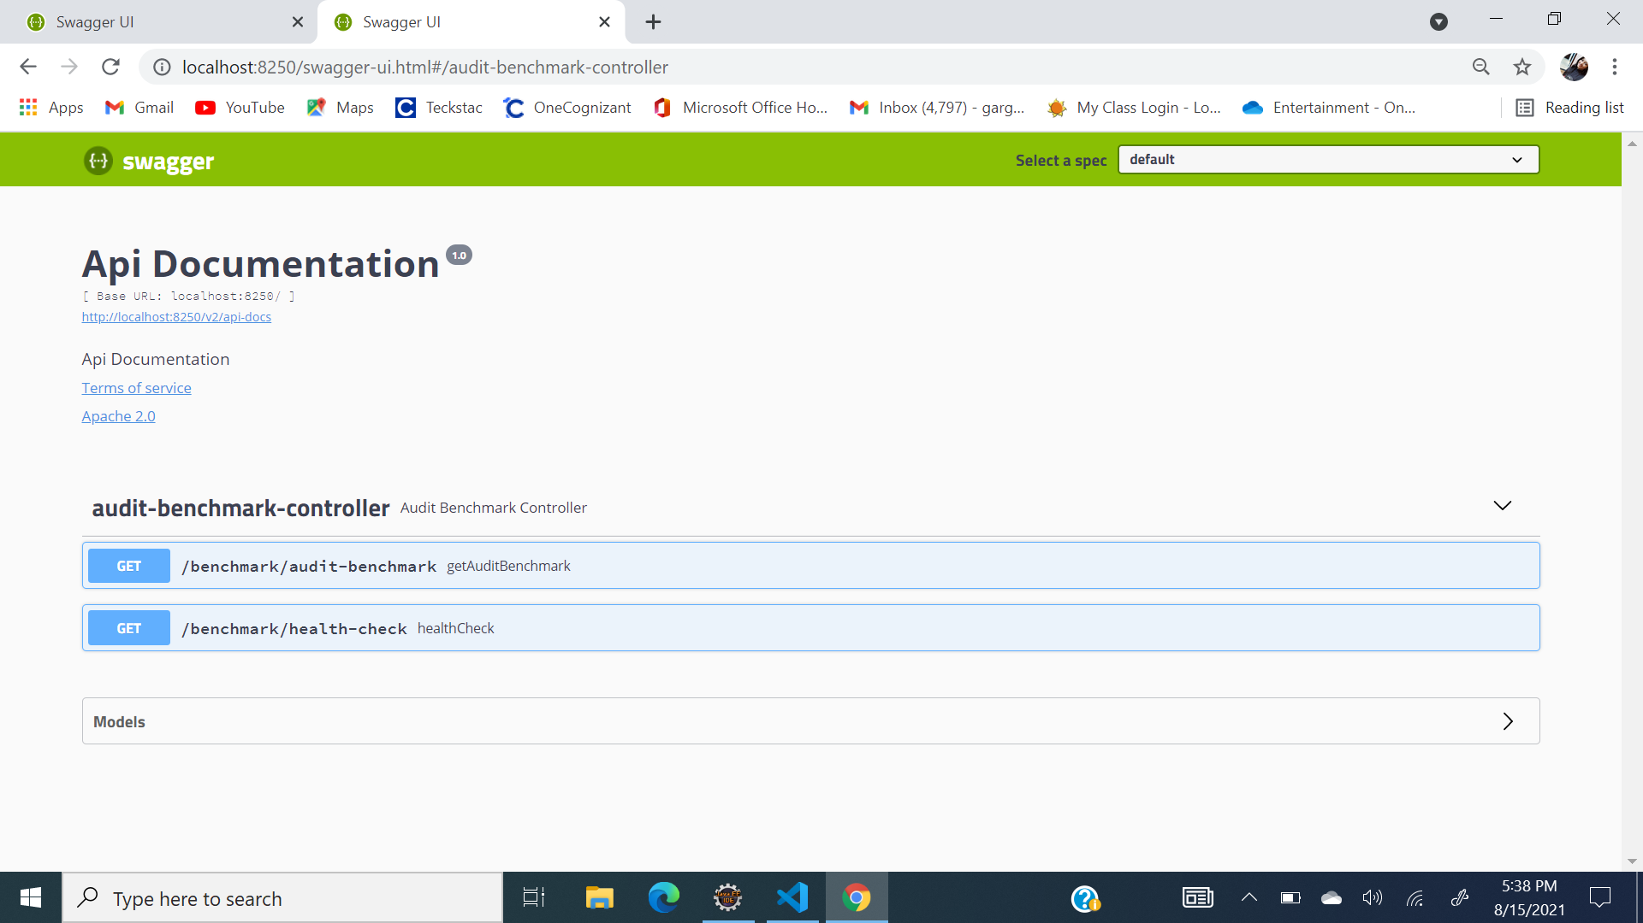
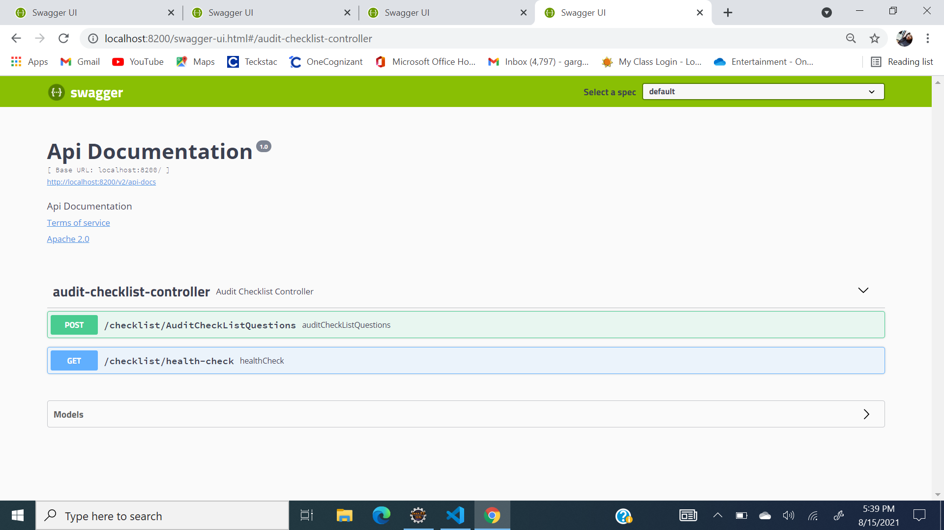
Swagger-UI

Slide 18
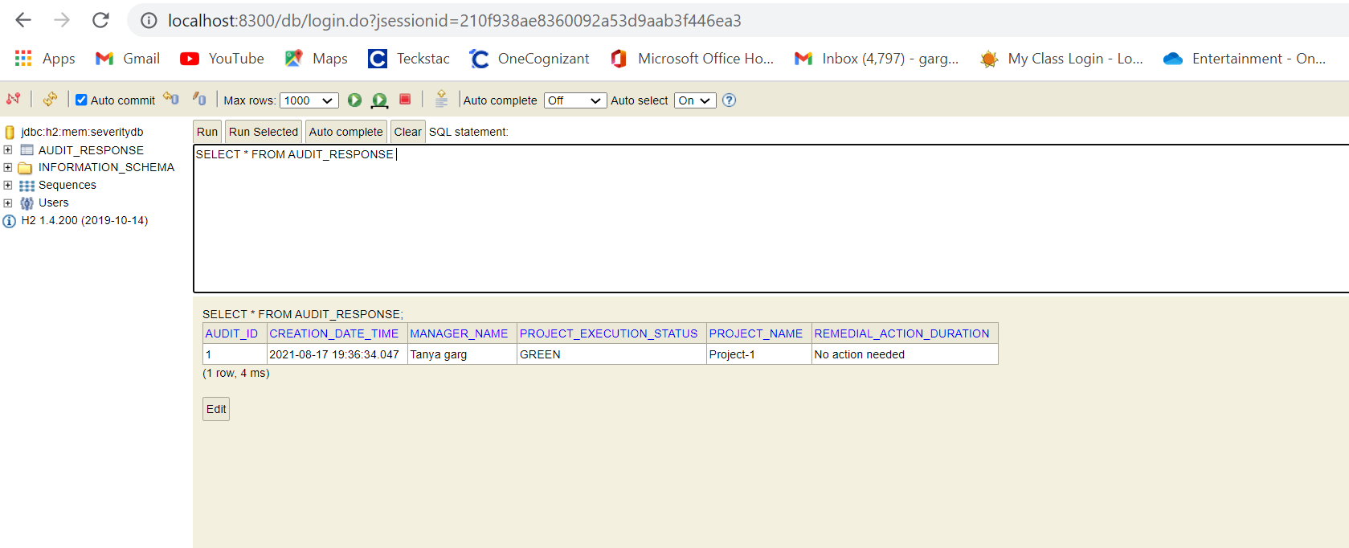
H2 Database

Slide 19
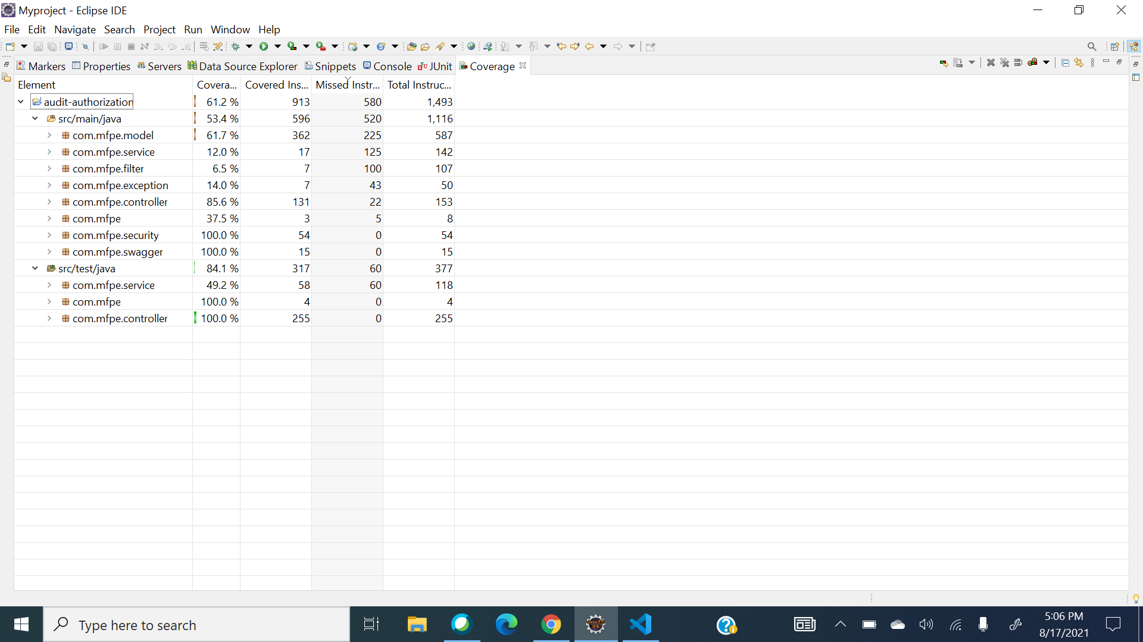

Code Coverage

Slide 20
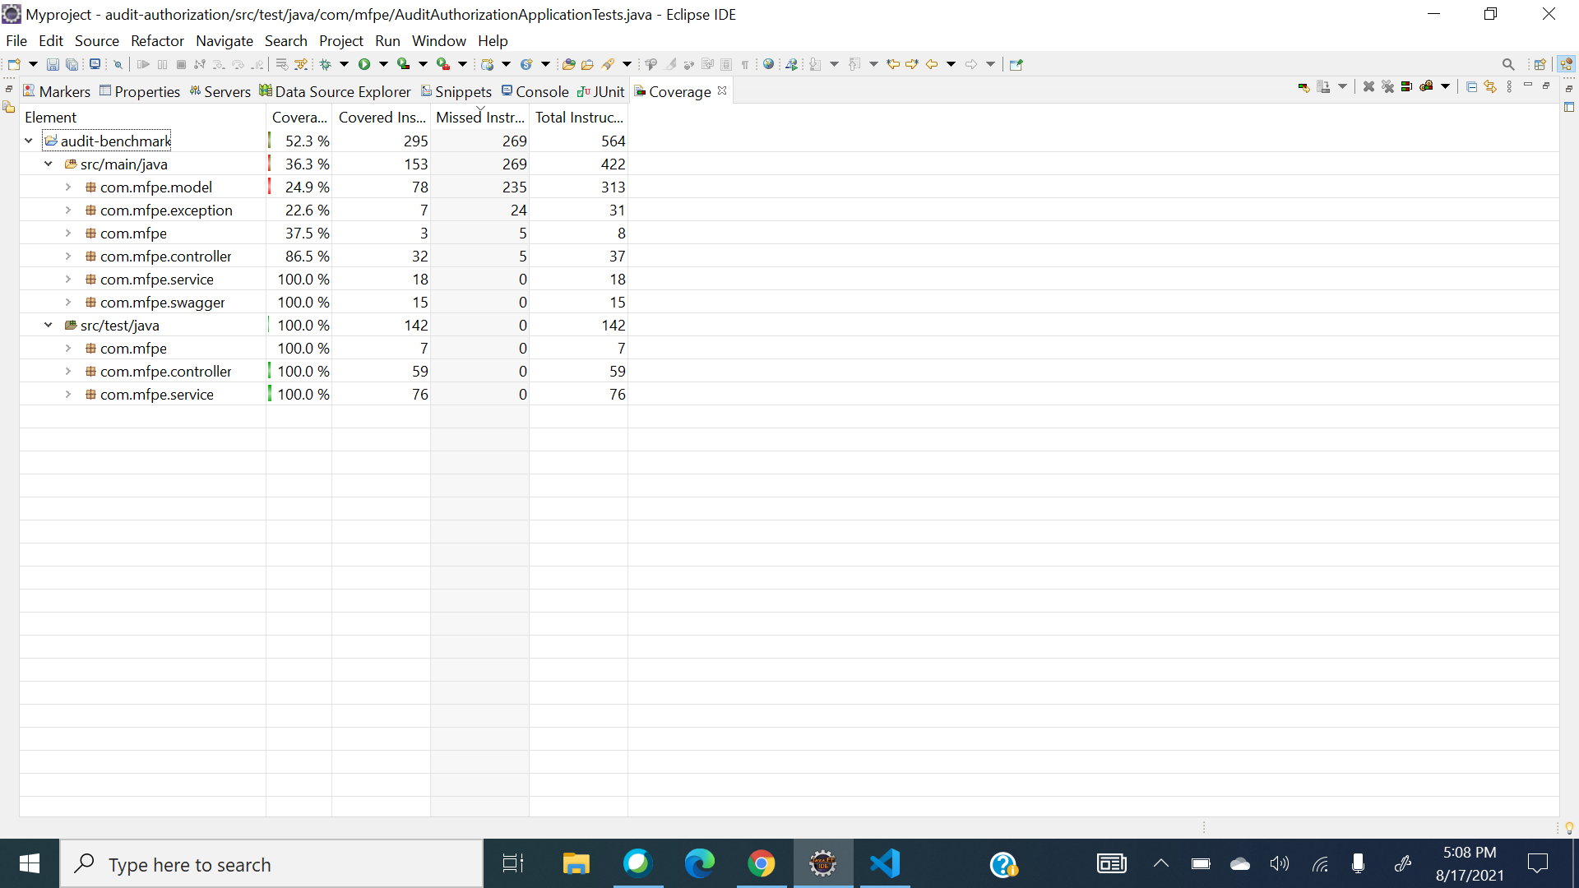

Code Coverage

Slide 21
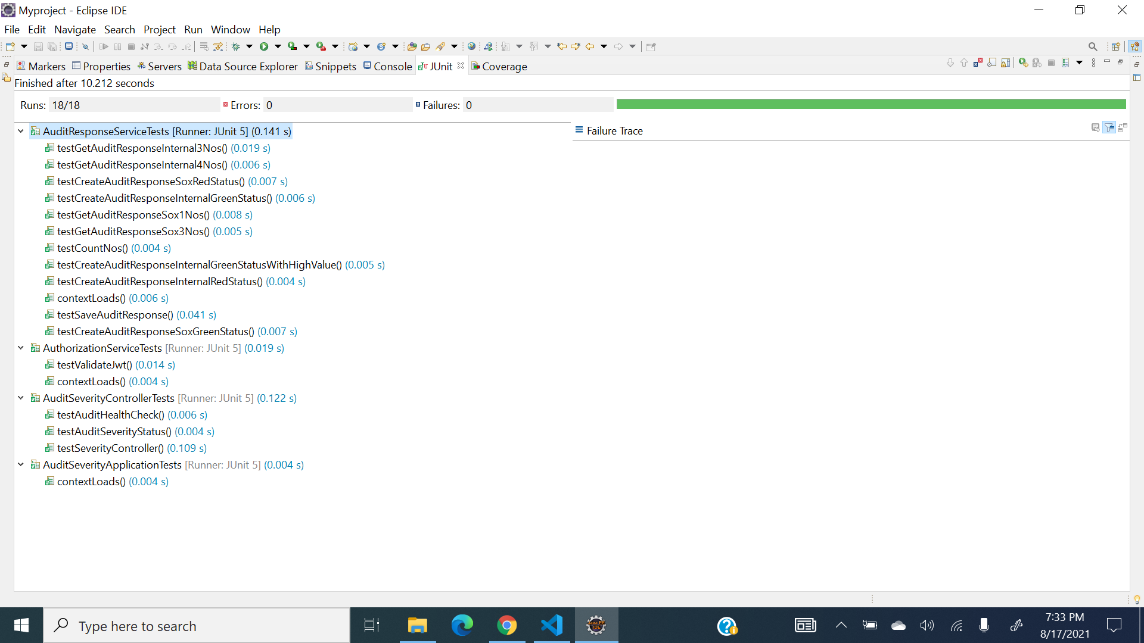
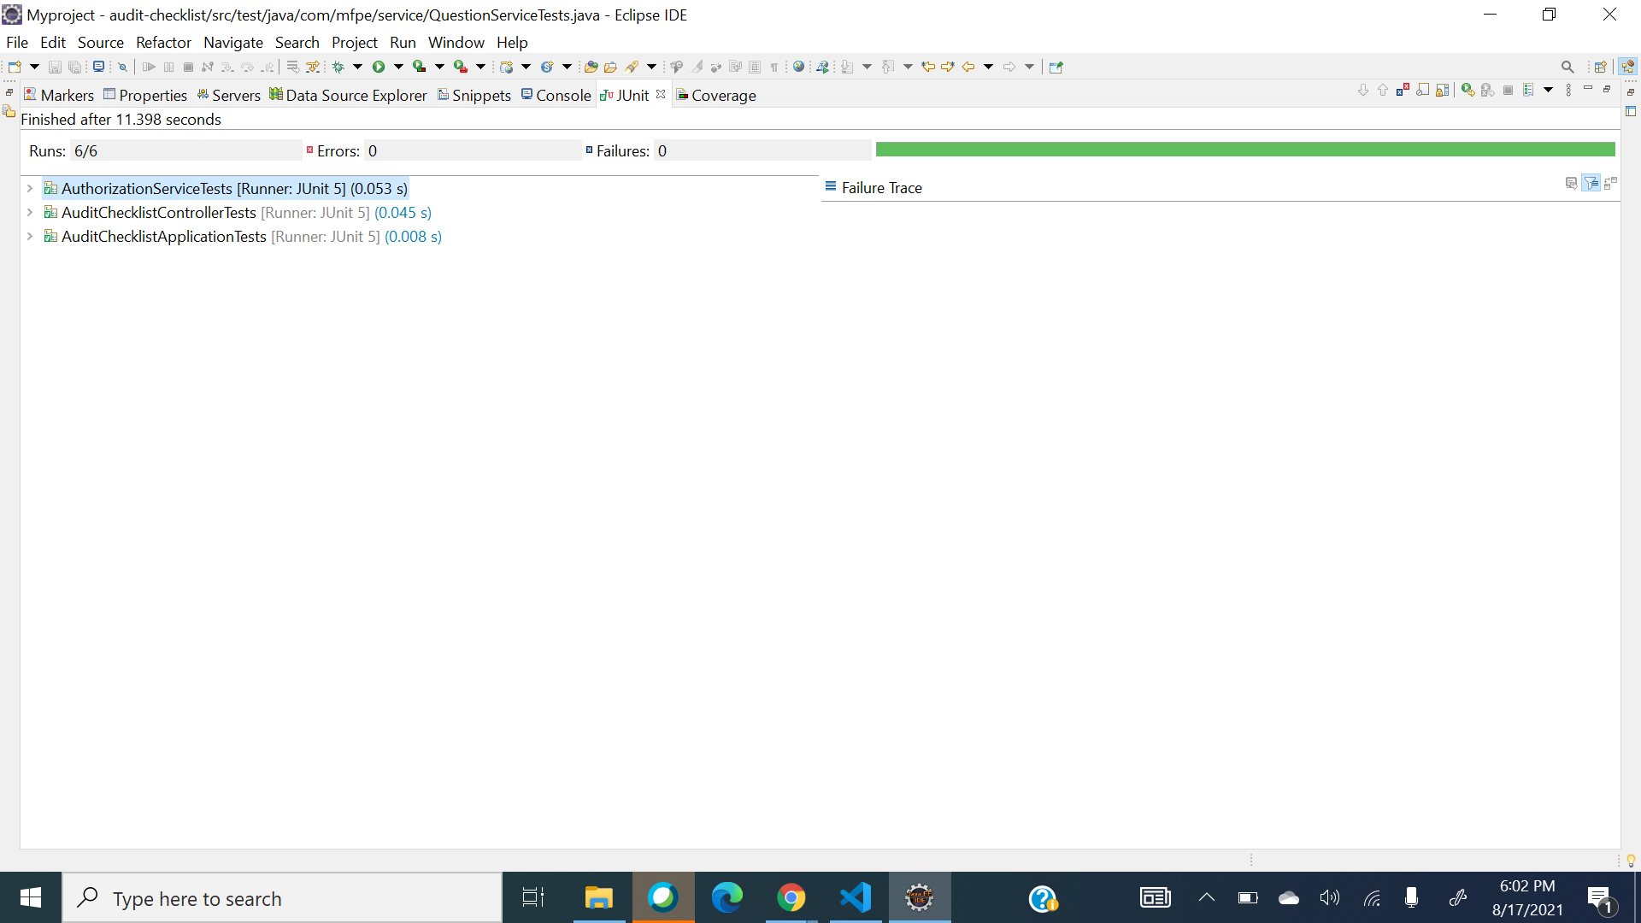
JUNIT

Slide 22
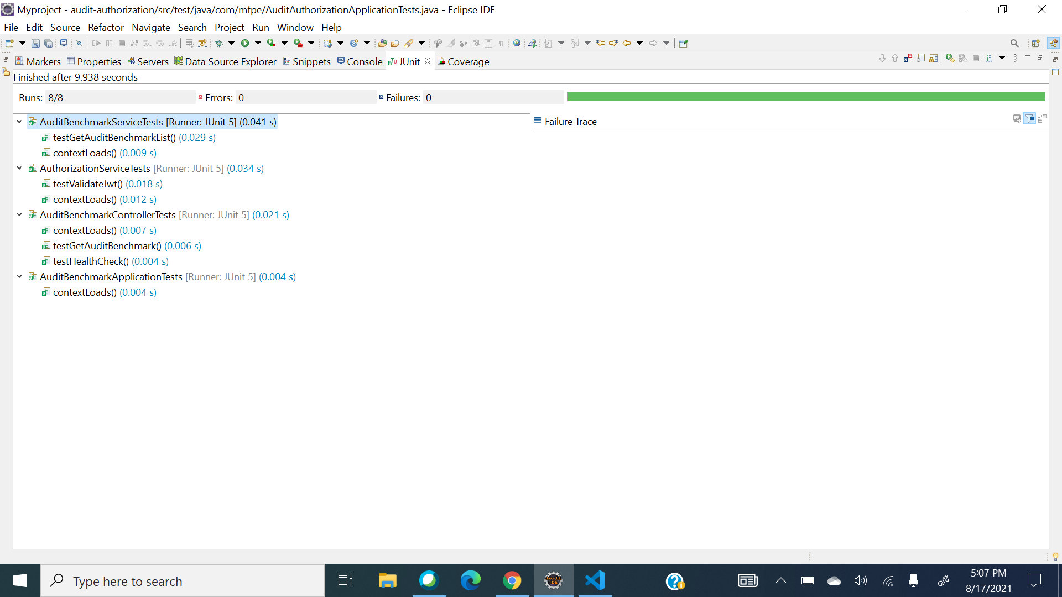
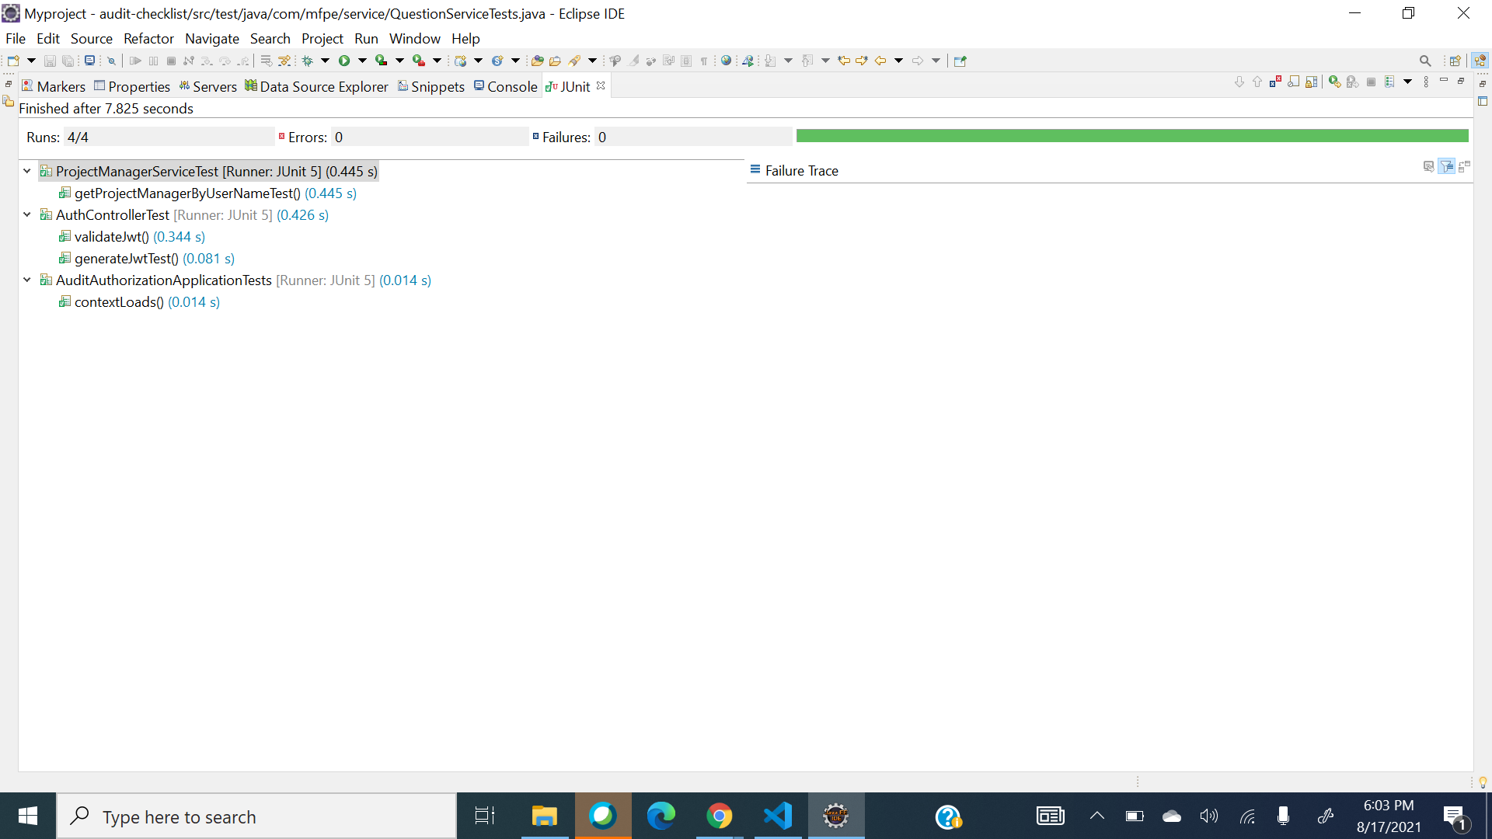
junit

Slide 23
Deployment Links
Execution video link - https://drive.google.com/file/d/1E0KwWbD0vX9-CMoxS8zTxU9NF4RGNIlz/view
ECR link - 885843804602.dkr.ecr.ap-southeast-1.amazonaws.com/audit-management
CodeCommit link - https://ap-southeast-1.console.aws.amazon.com/codesuite/codecommit/repositories/audit-checklist/browse?region=ap-southeast-1

Slide 24
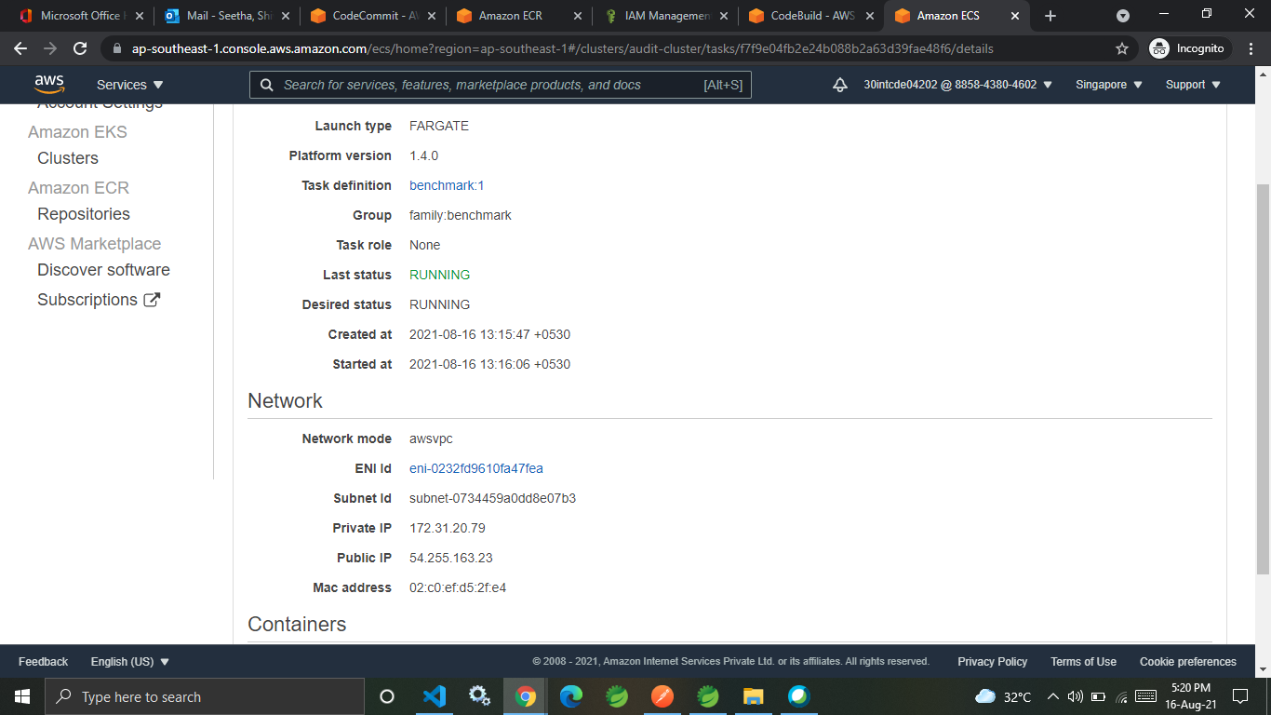
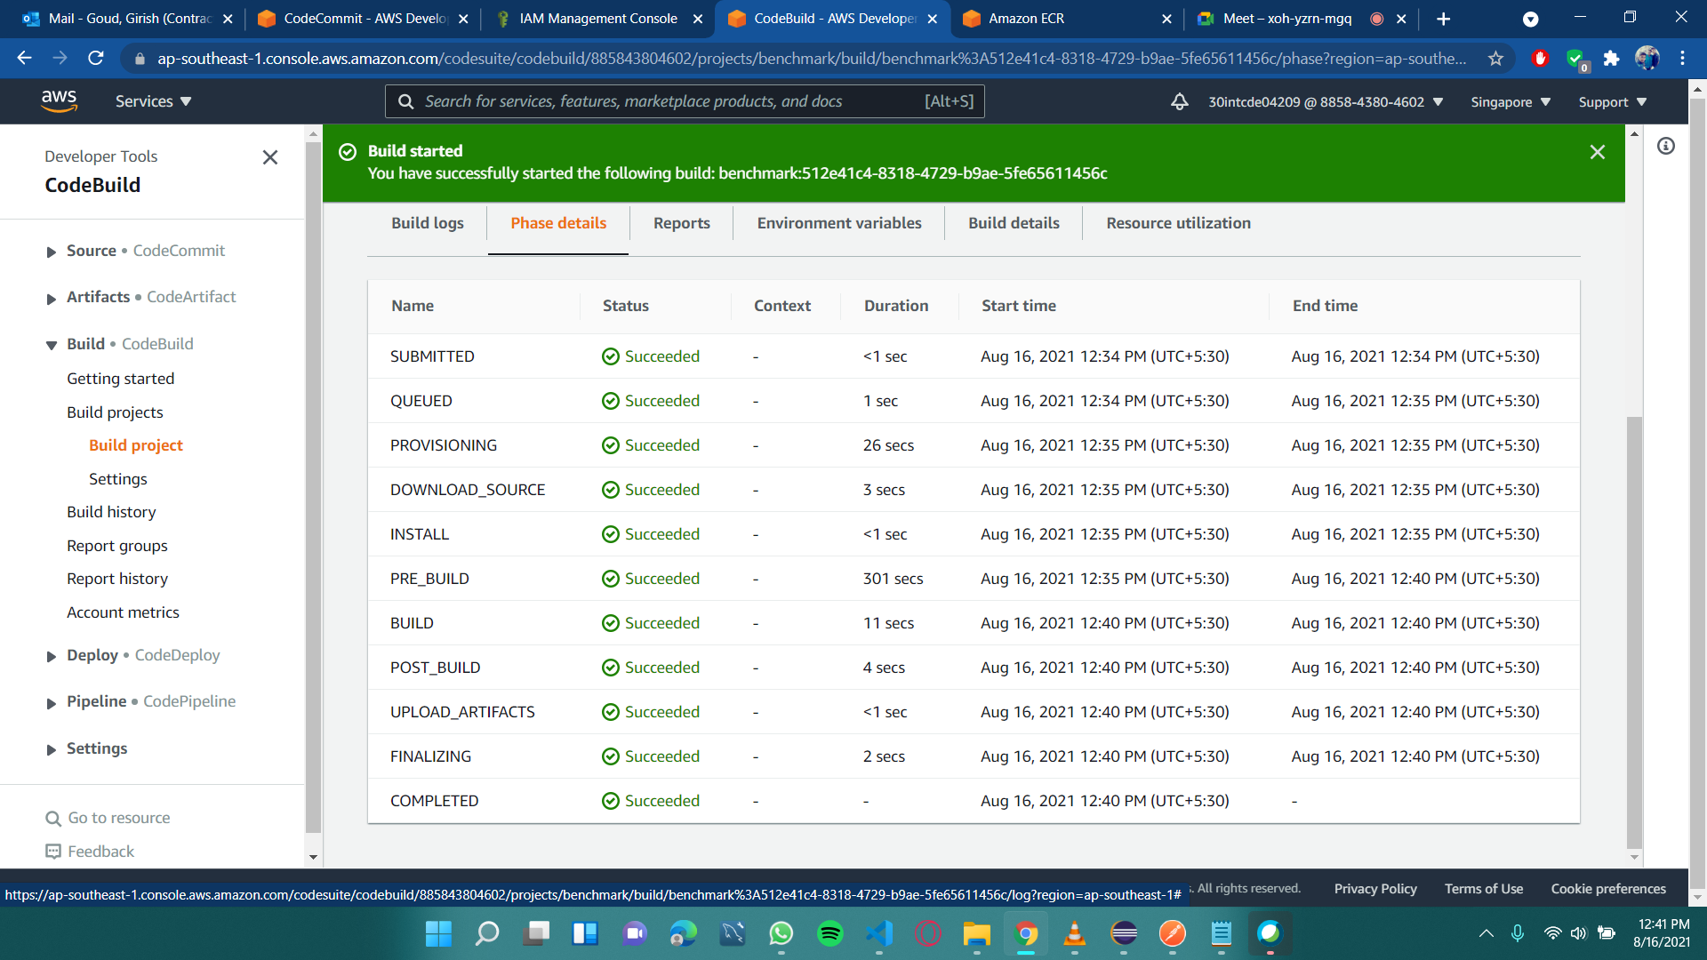
AWS deployment

Slide 25
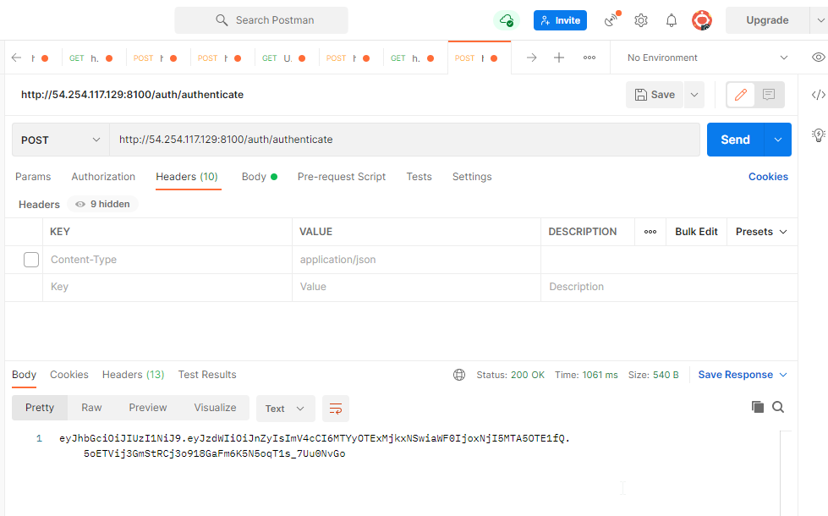
Postman

Slide 26
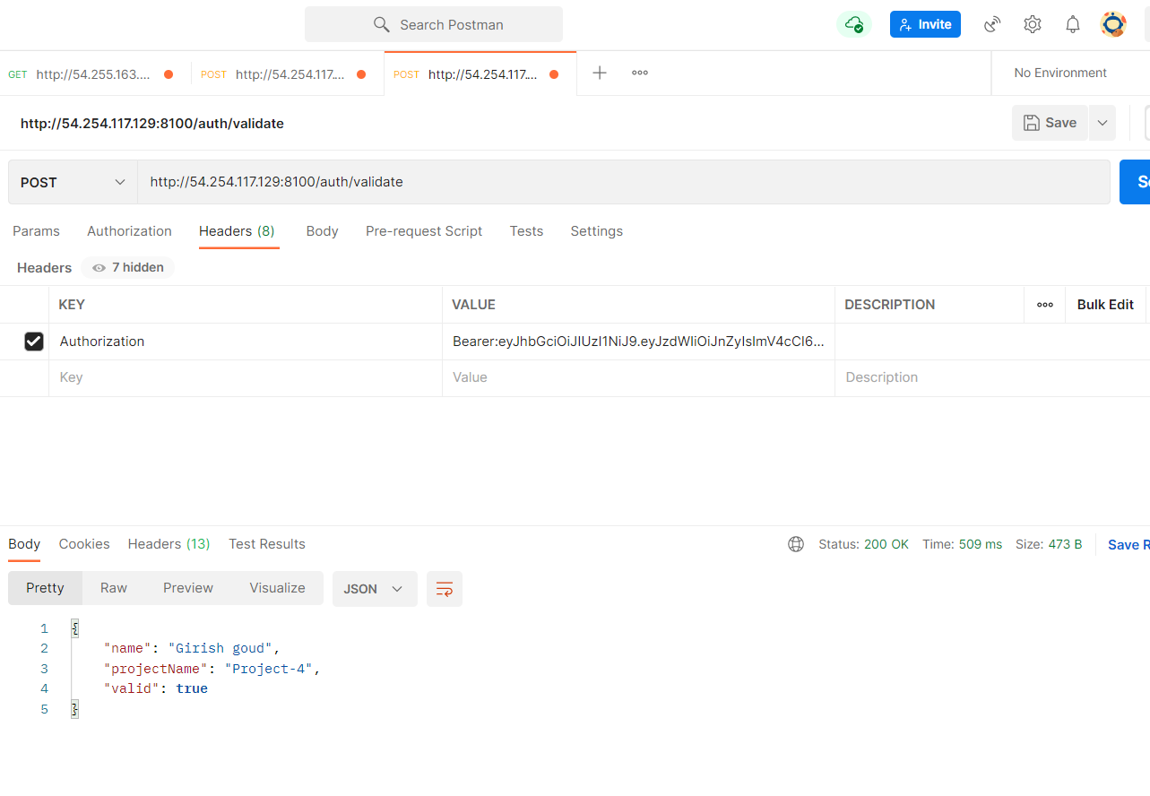
Postman

Slide 27
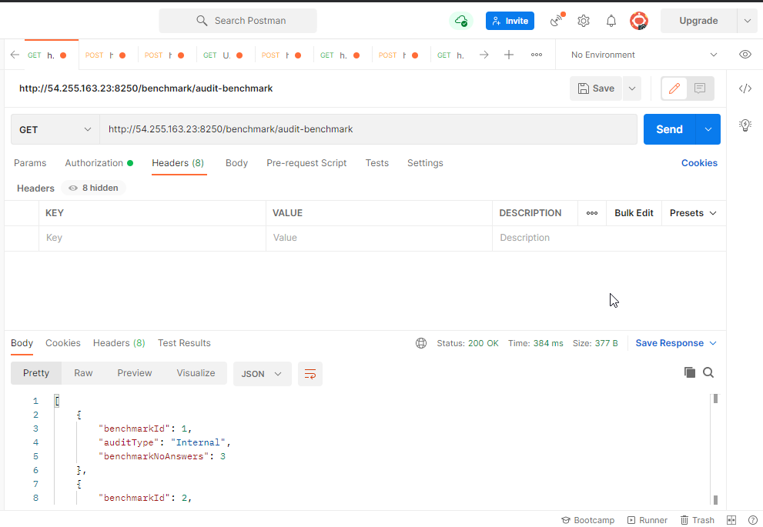
Postman

Slide 28
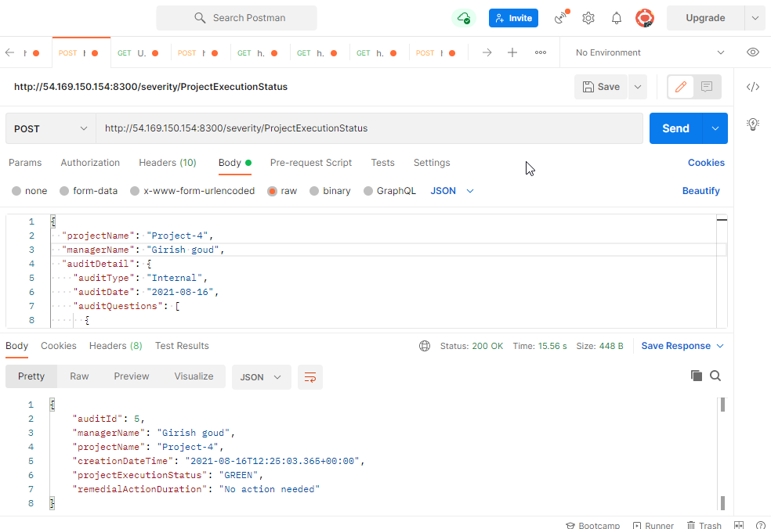
Postman

Slide 29
Learning Outcomes
Learn from each other
Time management, collaborative learning
Develop attitude necessary for success
Integrate theory and practice
Assess interests and abilities in FSE field
Develop communication and interpersonal skills
Build a record of work experience

Slide 30

Thank you

